Slide 1
Queues Asim Rehan
NUML

Slide 2
Queues
“A Queue is a special kind of list, where items are inserted at one end (the rear) And deleted at the other end (the front)”
Other Name:
First In First Out (FIFO)

Slide 3
Queues
A queue is like a line of people waiting for a bank teller. The queue has a front and a rear.
$ $
Rear
Front

Slide 4
Queues
New people must enter the queue at the rear.
$ $
Front
Rear
Notes:
In any case, when a new item enters a queue, it does so at the rear.

Slide 5
Queues
When an item is taken from the queue, it always comes from the front.
$ $
Front
Rear

Slide 6
Some examples
Billing counter
Booking movie tickets
Queue for paying bills
A print queue
Vehicles on toll-tax bridge
Luggage checking machine
Some others?

Slide 7
Applications of Queues
Operating system
multi-user/multitasking environments, where several users or task may be requesting the same resource simultaneously.
Communication Software
queues to hold information received over networks and dial up connections. (Information can be transmitted faster than it can be processed, so is placed in a queue waiting to be processed)
Notes:
Ready queue

Slide 8
Common Operations (Queue ADT)
MAKENULL(Q): Makes Queue Q be an empty list.
FRONT(Q): Returns the first element on Queue Q.
ENQUEUE(x,Q): Inserts element x at the end of Queue Q.
DEQUEUE(Q): Deletes the first element of Q.
ISEMPTY(Q): Returns true if and only if Q is an empty queue.

Slide 9
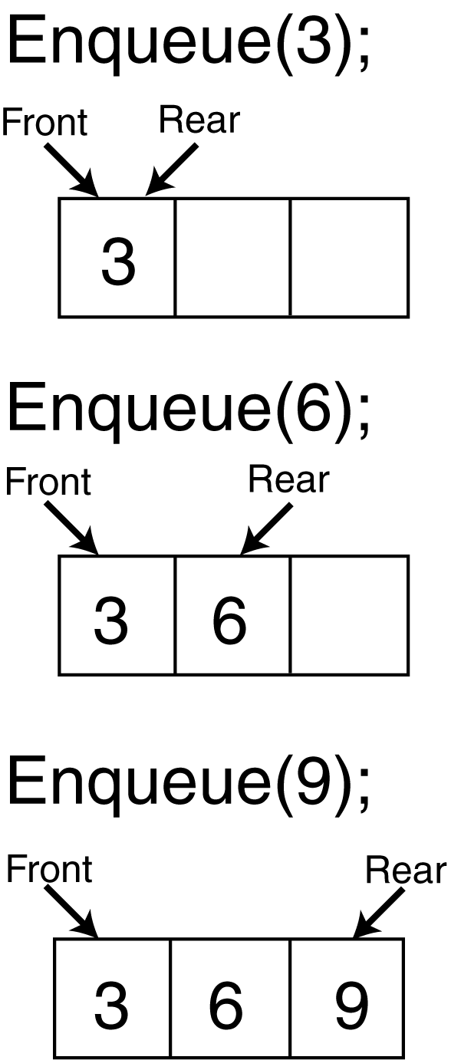
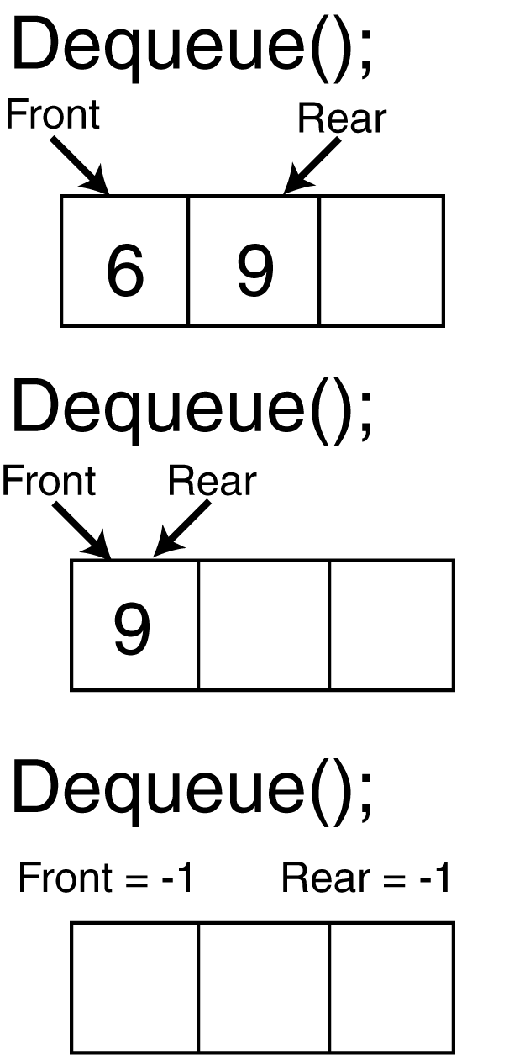

Slide 10
Implementation
Static
Queue is implemented by an array, and size of queue remains fix
Dynamic
A queue can be implemented as a linked list, and expand or shrink with each enqueue or dequeue operation.

Slide 11
Alternative Array Implementation
Use two counters that signify rear and front
Front
A
B
C
D
EF
G
First Element
Second Element
.
.
When queue is empty both front and rear are set to -1
While enqueueing increment rear by 1, and while dequeueing increment front by 1
When there is only one value in the Queue, both rear and front have same index
Rear
Last Element
maxlength

Slide 12
Array Implementation
Front= -1
Rear = -1
0 1 2 3 4 5 6 7 8
5
Front= 0
Rear = 0
0 1 2 3 4 5 6 7 8
5
4
Front= 0
Rear = 1
0 1 2 3 4 5 6 7 8

Slide 13
Array Implementation
5
4
6
7
8
7
6
0 1 2 3 4 5 6 7 8
Front=0
Rear=6
8
7
6
0 1 2 3 4 5 6 7 8
Front=4
Rear=6

Slide 14
Array Implementation
7
6
12
67
0 1 2 3 4 5 6 7 8
Front=5
Rear=8
How can we insert more elements? Rear index can not move beyond the last element….

